Slide 1
WFM 101
12 September, 2025
Prepared by: Carl Roldan Fernandez
Notes:
‹#›

Slide 2
TABLE OF CONTENTS
01
04
INTRODUCTION
STAFFING
02
05
CALL HANDLING
BILLING
03
06
PRODUCTIVITY
EXERCISES

Slide 3
INTRODUCTION
Core concept of WFM is to ensure we have the right number of people at the right time
PENNYMAC
Slight differences between WFM in contact center, or other service-based team
WNS
OPERATIONS
Drive both operational efficiency and customer satisfaction

Slide 4
01
02
CALL HANDLING
PRODUCTIVITY
4 MAIN POINTS
How interactions are managed
focuses on agents’ ability to manage time and resources throughout the day
Simplifying WFM into 4 main categories for this discussion
03
04
STAFFING
BILLING
how to determine to staff the right number of people at any given time
connect operations metrics to financial impact, ensuring WFM strategies are aligned with business goals

Slide 5
CALL HANDLING

Slide 6
CALL HANDLING
Call Routing / IVR Efficiency
Service Level
Call Volume Forecasting
Average Speed of Answer
Average Handle Time
Call Abandonment Rate
First Call Resolution

Slide 7


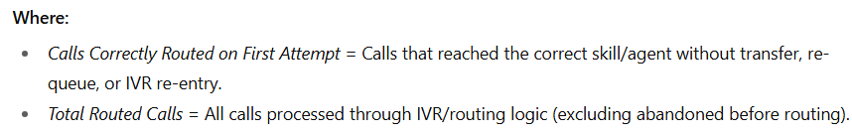
Call Routing / IVR Efficiency
DEFINITION
A measure of how effectively the IVR and routing logic direct contacts to the correct queue or skill group on the first attempt
High efficiency minimizes misroutes, reduces transfers, and lowers handle time.
FORMULA
FACTORS
IVR & Routing Design
Customer Behaviour
Operational & Data Factors
Measurement & Feedback Loop
‹#›

Slide 8

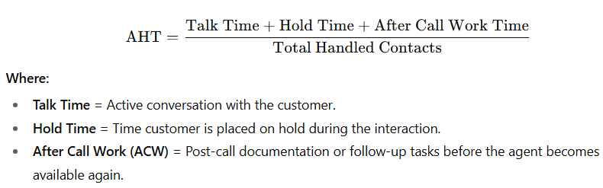
Average Handle Time
DEFINITION
Exercises
The average total time an agent spends on a contact, from the moment they answer until all after-call work (ACW) is completed.
High AHT means lesser call volume handled at the same time period. This also increases staffing needs to handle the same volume (linear change).
New CRM integration that automatically fills out half the after-call notes
FORMULA
FACTORS
Process Factors
People Factors
Technology
Contact Type Factors
External Factors
New product is launched
Several new hires join the floor, but their product knowledge is still developing
‹#›

Slide 9
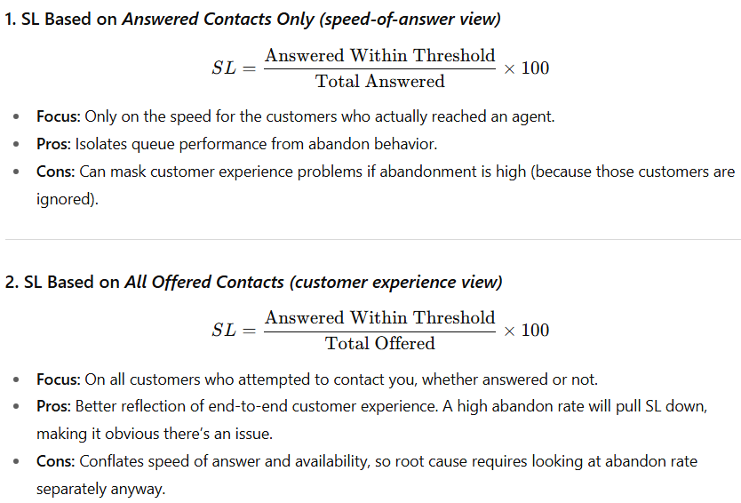
Service Level
DEFINITION
Exercises
A measure of the percentage of contacts answered within a predefined target time threshold, directly tied to workload planning and staffing
Unexpected Spike in Call Volume
FORMULA
FACTORS
Staffing Factors
Workload Factors
Routing / Queue Management
Operational Factors
External Factors
Overstaffing During Low Volume
Longer AHT Than Expected
‹#›

Slide 10
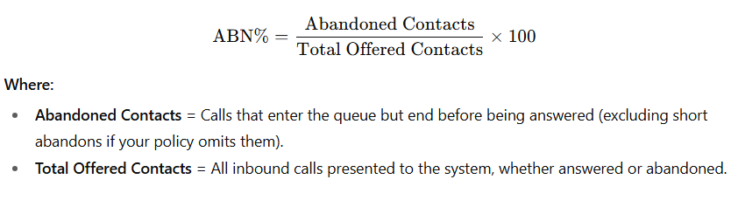
Call Abandonment Rate
DEFINITION
Exercises
The percentage of offered contacts where the caller disconnects before reaching an agent
Understaffing in the morning intervals
FORMULA
FACTORS
Staffing Factors
Workload Factors
Routing / Queue Factors
Customer Behaviour
Technology Factors
The forecast matched demand perfectly, staffing was scheduled accordingly.
A routing issue prevents calls from being assigned correctly.
‹#›

Slide 11
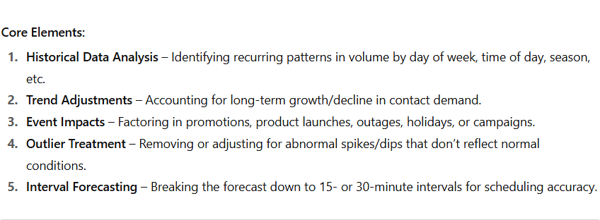
Call Volume Forecasting
DEFINITION
Exercises
The process of predicting the number of inbound contacts (calls, chats, emails, etc.) expected to arrive in a given time interval, based on historical data, patterns, and known events, so staffing can be planned to meet service goals.
The marketing team launches a surprise promotion that drives thousands of extra calls.
IMPORTANCE
FACTORS
Data Quality & Historical Accuracy
Pattern Stability & Historical Trends
External & Event-Based Factors
Operational & Structural Changes
Modelling & Forecasting Methodology
The forecast model includes past years’ data showing call volume spikes
An unexpected system outage happens, generating a huge call surge
‹#›

Slide 12
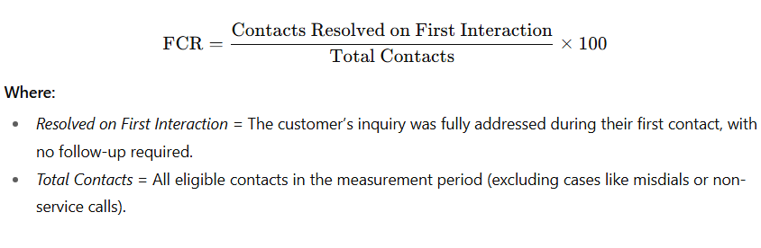
First Call Resolution
DEFINITION
Exercises
A metric that measures the percentage of customer issues resolved in the first interaction, without the need for the customer to call back, be transferred, or have the case escalated.
Agents are required to take knowledge base exercises regularly
FORMULA
FACTORS
Agent Capability & Performance
Process & Policy Design
Customer Behaviour & Preparedness
Technology & Systems
Call Routing & Skill Alignment
External or Event-Based Factors
A new policy requires agents to transfer all billing disputes to a specialized team
Agents must log into 3 different systems to resolve an account issue
‹#›

Slide 13
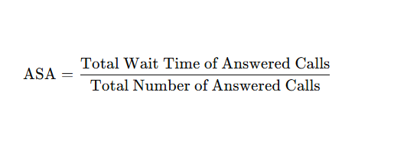
Average Speed of Answer
DEFINITION
Exercises
The average amount of time callers spend waiting in queue before being connected to an agent, excluding calls that abandon.
Call volume is much higher than forecasted
FORMULA
FACTORS
Staffing Levels
Calls offered vs. forecasted
Call Routing & IVR Efficiency
Technology & Systems
Call Routing & Skill Alignment
External or Event-Based Factors
Call volume is light, but a full team of agents is scheduled
Agents are taking longer than usual per call because of a new system
‹#›

Slide 14
PRODUCTIVITY

Slide 15
PRODUCTIVITY
OCCUPANCY
SCHEDULE ADHERENCE
The percentage of an agent’s available time that is actually spent handling customer interactions
The percentage of time an agent is available for calls exactly as scheduled
UTILIZATION
SCHEDULE CONFORMANCE
The percentage of total paid time that is spent on billable or productive tasks
Measures whether an agent worked the total scheduled shift duration, regardless of specific

Slide 16
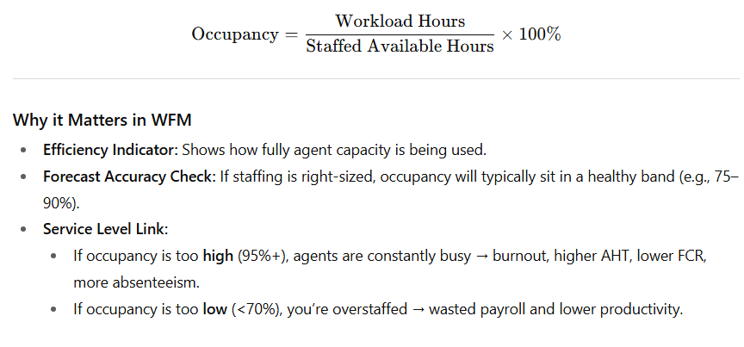
Occupancy
DEFINITION
Exercises
Occupancy is the percentage of time that available agents are actively engaged in handling contacts compared to their total logged-in, available-to-work time
Call volume is heavy, but staffing matches the forecast
FORMULA
FACTORS
Staffing Levels
Forecast Accuracy
Multi-Skilling and Call Routing
Customer Behaviour
Technology and Systems
Only a few calls are arriving, but many agents are scheduled
Agents must document calls in detail after each interaction
‹#›

Slide 17
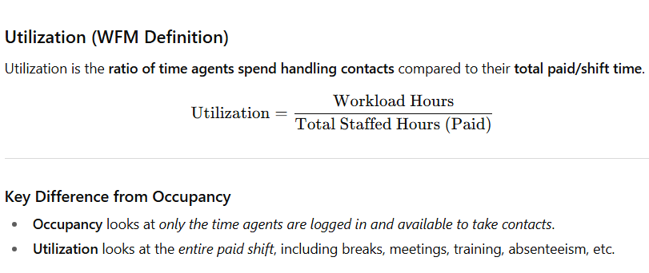
Utilization
DEFINITION
Exercises
Utilization is the ratio of time agents spend handling contacts compared to their total paid/shift time
Agents spend 2–3 hours in training and meetings instead of handling calls
FORMULA
FACTORS
Staffing Levels
Forecast Accuracy
Schedule Adherence and Conformance
Multi-Skilling and Call Routing
Channel Mix & Workload Type
Technology and Process Delays
Overtime agents spend nearly all of their shift taking calls
Supervisors allow extra-long breaks due to system downtime
‹#›

Slide 18

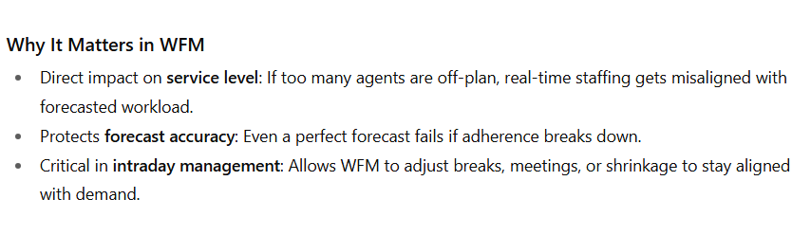
Schedule Adherence
DEFINITION
Exercises
Schedule adherence is the percentage of time an agent follows their assigned schedule during the period they are logged in.
An agent is scheduled to start at 9:00 a.m. but logs in at 9:15 a.m
FORMULA
FACTORS
Agent Behaviour
RTM & Supervision
System/Technology Issues
Schedule Quality
Unplanned Shrinkage
Workload Variability
An agent takes all breaks and lunches at the times as scheduled
An agent stays in ACW for 10 minutes after each call
‹#›

Slide 19

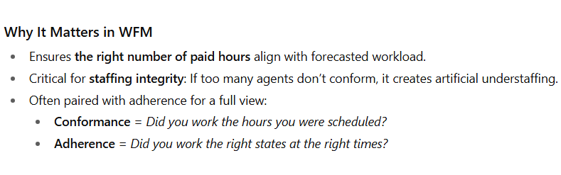
Schedule Conformance
DEFINITION
Exercises
Schedule conformance is the percentage of time an agent actually works compared to the total time they were scheduled to work
An agent is scheduled 9:00–5:00 but instead works 9:30–5:30
FORMULA
FACTORS
Agent Behaviour
RTM & Supervision
System/Technology Issues
Schedule Quality
Absenteeism/Tardiness
Overtime/Extra Hours
An agent is scheduled for 8 hours but leaves after 6 hours
An agent is scheduled for 8 hours but stays an extra 2 hours
‹#›

Slide 20
STAFFING

Slide 21
STAFFING
REQUIRED FTE
SHRINKAGE
The total number of full-time agents needed to handle forecasted workload while meeting performance targets
The percentage of paid time that agents are not available to handle calls
REQUIRED AVAILABLE FTE
SHOW RATE
The number of agents needed to be actively available to take calls, after accounting for non-productive time.
The percentage of scheduled agents who actually show up for work as planned
CAPACITY PLANNING
ATTRITION
The strategic process of determining the number of agents required over a long-term horizon to meet service level goals
The rate at which employees leave the organization over a given period

Slide 22
FTE
Actual Available FTE
3
Considering scheduling factors, training duration, and attrition
Actual Available FTE
Required Available FTE
2
Considering shrinkages
Required Available FTE
Required FTE
Required FTE
1
Considering KPI/SLA agreements (for a contact center: OCC, AHT, volume)

Slide 23
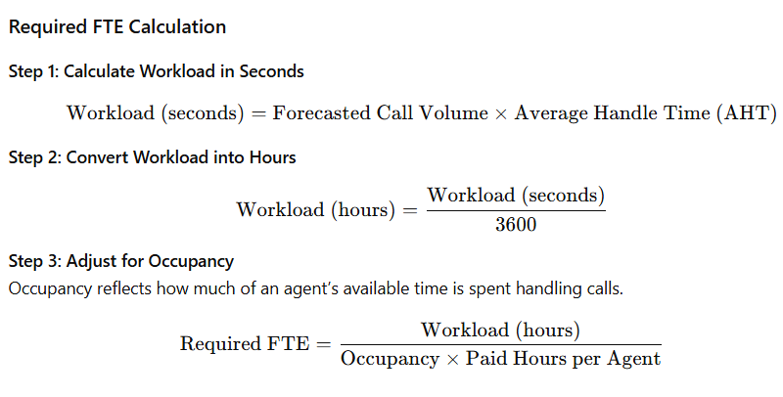
Required FTE
DEFINITION
Exercises
The number of full-time agents needed to handle the forecasted workload while meeting target service levels.
Call volume is forecasted to increase by 20% next week
FORMULA
FACTORS
AHT
Volume
Occupancy
Service Level Agreement
Call Arrival Pattern
Channel Mix
SL target increases from 80/20 to 90/20
A process improvement reduces AHT from 6 minutes to 4 minutes
‹#›

Slide 24
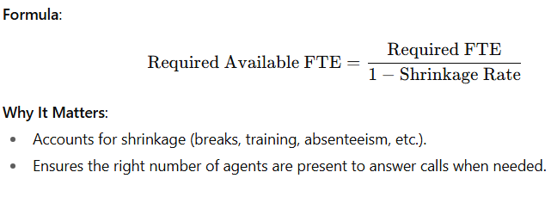
Required Available FTE
DEFINITION
Exercises
The number of agents that must be actively available on the floor to meet performance targets
Planned training sessions are added
FORMULA
FACTORS
Shrinkage
Factors affecting Required FTE
After process improvements, agents handle the same workload with less AHT
Several agents call in sick unexpectedly
‹#›

Slide 25
SHRINKAGE
UNPLANNED IN-OFFICE
PLANNED IN-OFFICE
System issues, real-time pullouts, wrong aux tagging, extended breaks
IN-OFFICE
Scheduled trainings, pullouts, team huddles, breaks
UNPLANNED
SHRINKAGE TYPE
PLANNED
UNPLANNED OUT-OF-OFFICE
PLANNED OUT-OF-OFFICE
Sick leave, emergency leave, NCNS, tardiness, early logout
Vacation leaves, LOA, maternal/paternal leaves
OUT-OF-OFFICE

Slide 26
STAFFING
REQUIRED FTE
SHRINKAGE
The total number of full-time agents needed to handle forecasted workload while meeting performance targets
The percentage of paid time that agents are not available to handle calls
REQUIRED AVAILABLE FTE
SHOW RATE
The number of agents needed to be actively available to take calls, after accounting for non-productive time.
The percentage of scheduled agents who actually show up for work as planned
CAPACITY PLANNING
ATTRITION
The strategic process of determining the number of agents required over a long-term horizon to meet service level goals
The rate at which employees leave the organization over a given period

Slide 27
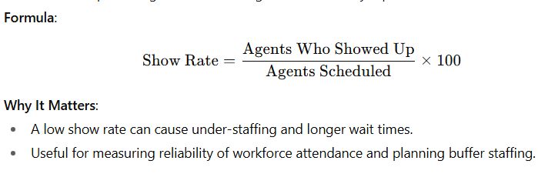
Show Rate
DEFINITION
The percentage of scheduled agents who actually report to work
FORMULA
FACTORS
Agent Behaviour
System/Technology Issues
Schedule Quality
External Factors
Management and Communication
‹#›

Slide 28
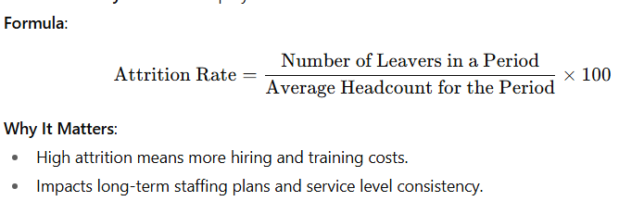
Attrition
DEFINITION
The percentage of employees who leave the organization during a given period
FORMULA
FACTORS
Job Satisfaction
Compensation and Benefits
Workload and Stress
Management and Leadership
Operational Factors
Personal Factors
‹#›

Slide 29
BILLING

Slide 30
BILLING
BILLING TYPE
PAID PRODUCTION HOURS
TOTAL WORKED HOURS
BILLABLE HOURS
BILL TO PAY
The contractual structure under which the client is billed.
Usual billing type for a contact center includes:
By the minute, By the hour, By FTE, By piece
The number of hours an agent is paid for while actively handling production-related work
The number of hours the agent reported to work, regardless if doing productive work or not, plus any time adjustments
The number of hours that can be billed to the client
A financial efficiency metric showing the ratio of billable hours to paid hours.

Slide 31
EXERCISES
01
04
Is there a chance that you will fail an interval even if you have enough show rate, passing AHT, and accurate forecast?
When just considering the productive agents, can HC be greater than FTE?
02
05
Can Service Level be greater than Answer Rate?
Why is it important to have a good Bill To Pay?
03
What is indicated if Occupancy is at 99%, but agent still has low Utilization?
06
Why should the actual available FTE be greater than the required available FTE?

Slide 32
THANK YOU

